Slide 1
Recitation3
李磊
2023/9/27

Slide 2
Announcements
下周放假, 没有大班, 小班课
bomblab应该快发布了(本周五), 应该也是12天due, 14天ddl
datalab 10/4due, 10/6ddl, 请大家合理安排时间
https://godbolt.org 在学汇编的时候挺好用的

Slide 3
Schedule
曾为帅, 张立恒同学回课
助教讲述课程重点内容以及相关题目
讲讲bomblab?

Slide 4
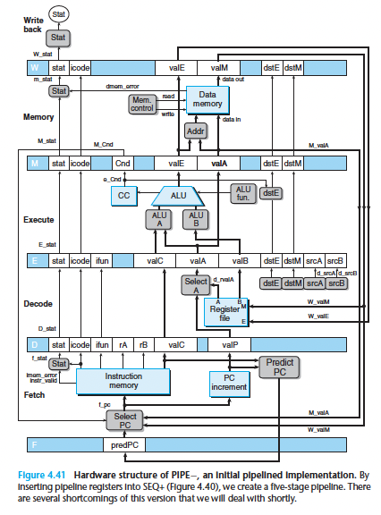
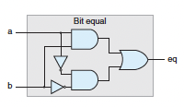
Overview
temp = v[k];
v[k] = v[k+1];
v[k+1] = temp;
High Level Language Program (e.g., C)
movl 0(%rdi), %eax
movl 4(%rdi), %edx
movl %edx, 0(%rdi)
movl %eax, 4(%rdi)
Assembly Language Program (e.g., x86, RISC-V)
Machine Language Program (e.g., x86, RISC-V)
0x 8b 07 8b 57 04 89 17 89 47 04
Hardware Architecture Description (e.g., block diagrams)
Logic Circuit Description (Circuit Schematic Diagrams)

Slide 5
Assembly Language
Basic job of a CPU: execute lots of instructions.
Instructions are the primitive operations that the CPU may execute.
Different CPUs implement different sets of instructions. The set of instructions a particular CPU implements is an Instruction Set Architecture (ISA).
Examples: ARM (cell phones), Intel x86 (i9, i7, i5, i3), IBM Power, IBM/Motorola PowerPC (old Macs), MIPS, RISC-V, ...

Slide 6
Assembly Variables: Registers
Unlike HLL like C or python, assembly cannot use variables
Why not? Keep Hardware Simple
Assembly operands are registers
Limited number of special locations built directly in CPU
Operations can only be performed on these!
Benefit: Since registers are directly in hardware, they’re very fast (faster than 0.25ns)

Slide 7
Registers are Inside the Processor
Processor
Memory
Control
Read/Write
Address
Datapath
Program Counter (PC)
Bytes
Registers
Write Data
Read Data
Arithmetic-Logic Unit (ALU)
Processor-Memory Interface
(12)

Slide 8
Registers
Since registers are in hardware, there is a predetermined number of them
16 general-purpose registers in x86-64
Each x86-64 register is 64 bits wide

Slide 9
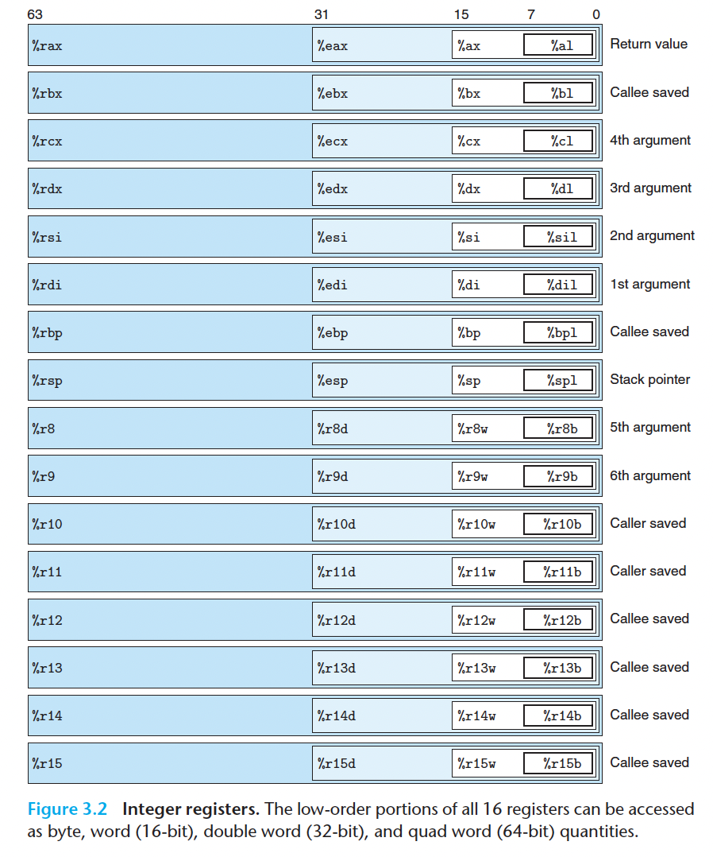

Slide 10
Registers
Used for copying, generating, 1, 2, 4, 8bytes values.
Rememeber that instructions that generate 4-byte quantities set the upper 4 bytes of the register to zero.
Why? Backward compatibility!
Get familiar with the name of the 16 registers.
For now, just remember that rsp is the stack pointer.
rip is not one of the 16 general-purpose registers.

Slide 11
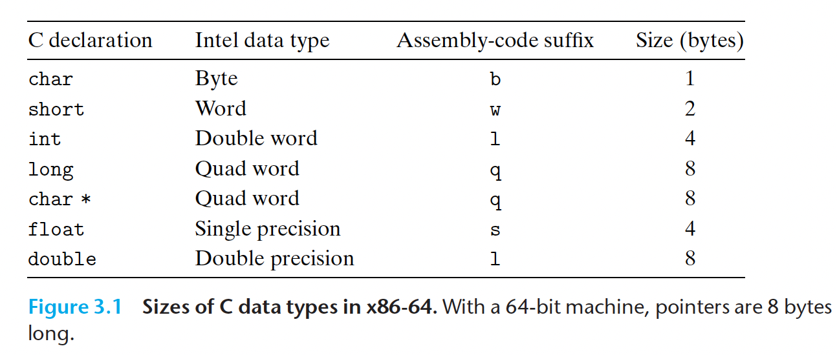
Data Formats

Slide 12
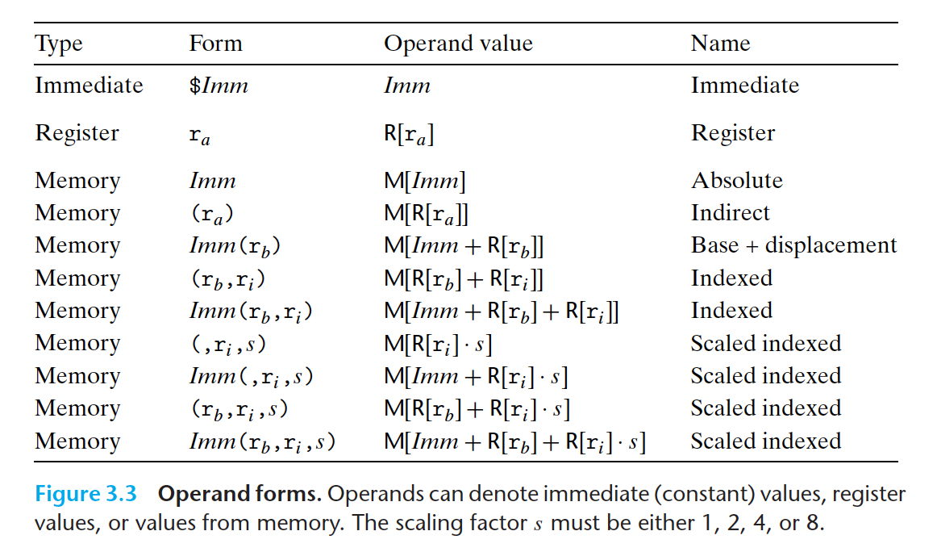
Operand Specifiers

Slide 13
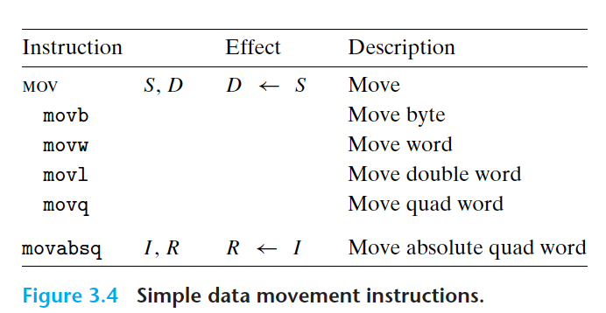
Data movement instructions
When movl has a register as the destination, it will also set the high-order 4 bytes of the register to 0.
Copying a value from one memory location to another requires two instructions.

Slide 14
Data movement instructions
What is the difference between movq & movabsq?
movabsq can have a 64-bit immediate value as its source operand
While movq can only have a 32-bit immediate value as its source operand and sign extend it.
For x within [0x80000000, 0xffffffff] and [0x100000000, 0xffffffff7fffffff] -> movabsq
For other numbers, both instructions are okay!

Slide 15
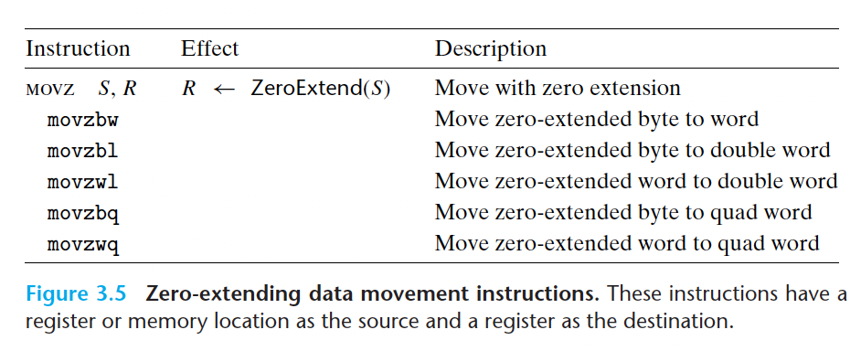
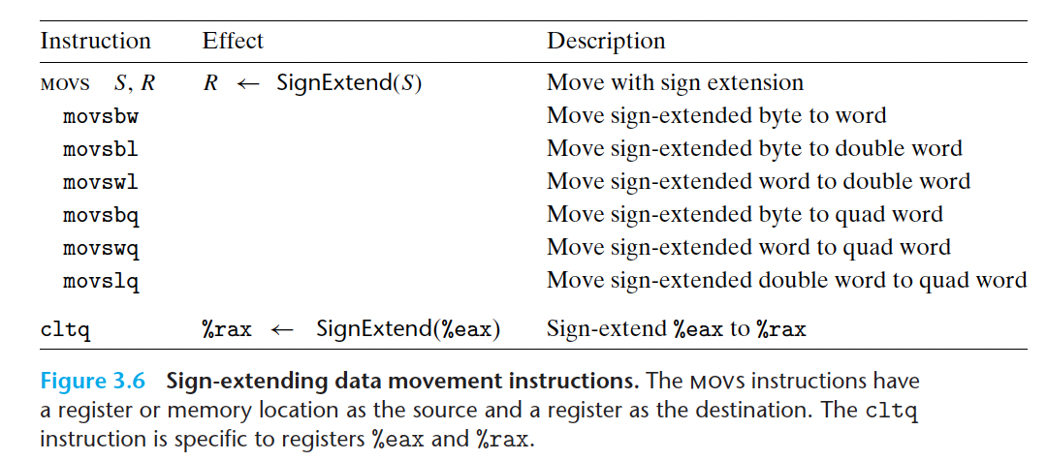
Data movement instructions
Zero extend and sign extend.
There is no movzlq, because it is the same as movl.
cltq is same as
movslq %eax,%rax
For more compact encoding!

Slide 16
Example
下面不是 X86-64正确的寻址方式的指令是____.
A.movl $34,(%eax)
B.movl (%eax),%eax
C.movl $23,10(%edx, %eax)
D.movl (%eax),8(%ebx)

Slide 17
Example
下面不是 X86-64正确的寻址方式的指令是____. D
A.movl $34,(%eax)
B.movl (%eax),%eax
C.movl $23,10(%edx, %eax)
D.movl (%eax),8(%ebx)

Slide 18
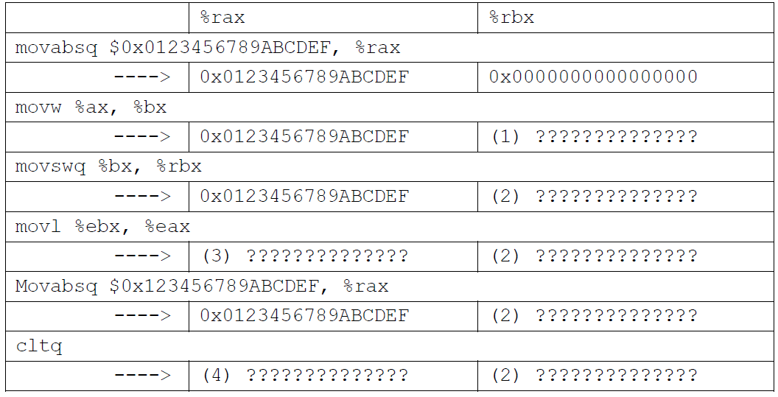
Data movement instructions
假设%rax、%rbx的初始值都是0.请据汇编代码将???填写完整.
(1)________. (2)________. (3)________. (4)________.

Slide 19
Data movement instructions
假设%rax、%rbx的初始值都是0.请据汇编代码将???填写完整.
(1) 0x000000000000CDEF (2) 0xFFFFFFFFFFFFCDEF
(3) 0x00000000FFFFCDEF (4) 0xFFFFFFFF89ABCDEF

Slide 20
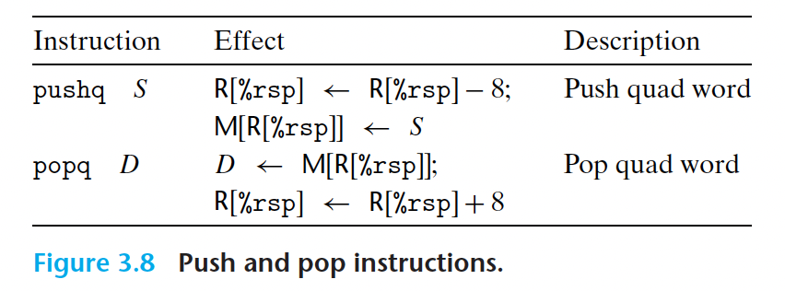
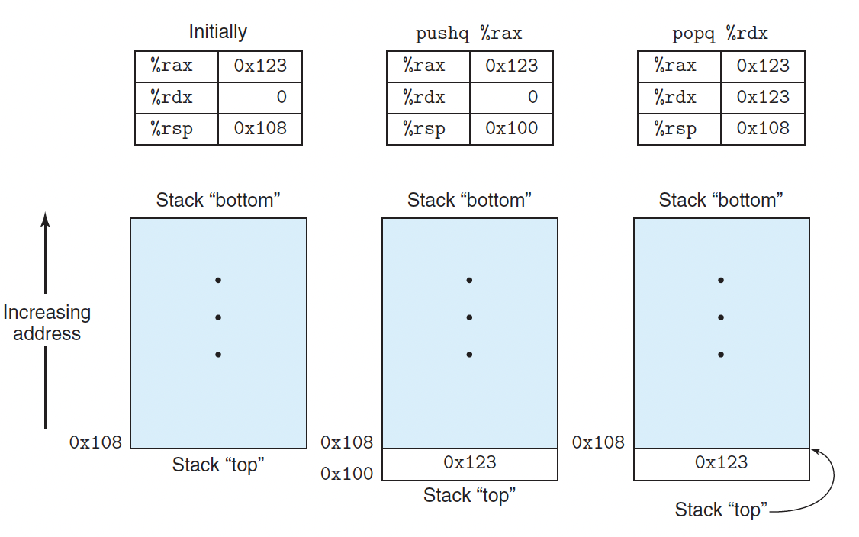
Pushing and Popping Stack Data
Remember that stack grows upside down.

Slide 21
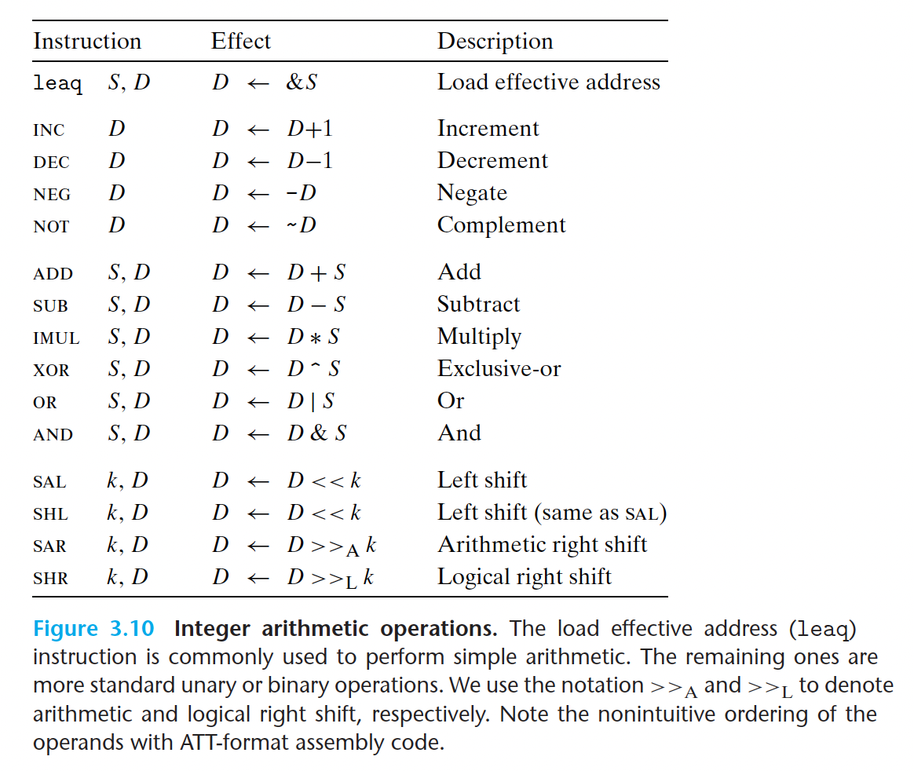
Arithmetic and Logical Operations
Something you should notice
The source is before the destination.
Leaq is often used as arithmetic operations.
Shift operations can specify the shift amount as an immediate value or with register %cl

Slide 22
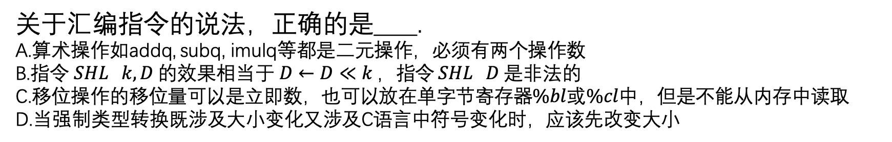
Examples
关于汇编指令的说法，正确的是____.
A.算术操作如addq, subq, imulq等都是二元操作，必须有两个操作数
B.指令 $SHL k, D$的效果相当于$D←D≪k$，指令 $SHL D$是非法的
C.移位操作的移位量可以是立即数，也可以放在单字节寄存器$\%bl$或$\%cl$中，但是不能从内存中读取
D.当强制类型转换既涉及大小变化又涉及C语言中符号变化时，应该先改变大小

Slide 23
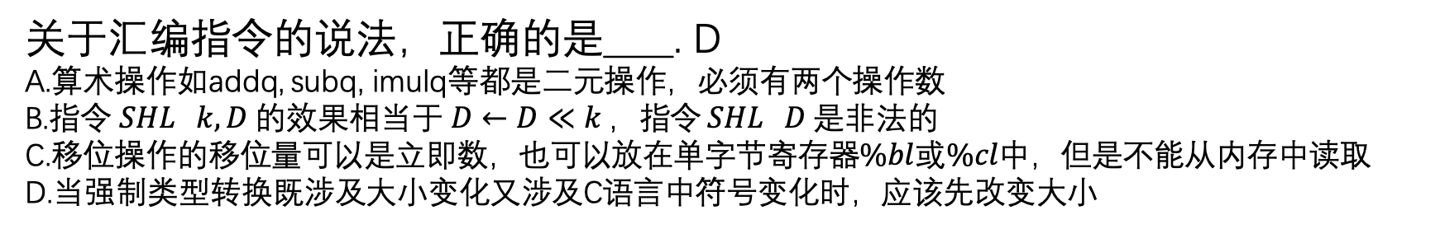
Examples
关于汇编指令的说法，正确的是____. D
A.算术操作如addq, subq, imulq等都是二元操作，必须有两个操作数
B.指令 $SHL k, D$的效果相当于$D←D≪k$，指令 $SHL D$是非法的
C.移位操作的移位量可以是立即数，也可以放在单字节寄存器$\%bl$或$\%cl$中，但是不能从内存中读取
D.当强制类型转换既涉及大小变化又涉及C语言中符号变化时，应该先改变大小

Slide 24
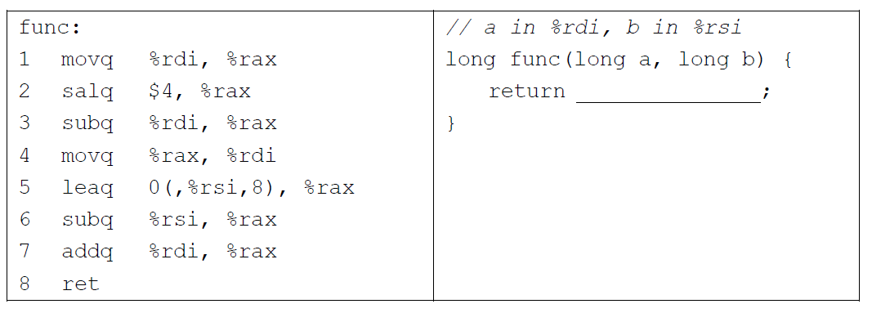
Examples
将下列汇编代码翻译成C代码,横线处应该填写________
____.

Slide 25
Examples
将下列汇编代码翻译成C代码,横线处应该填写a*15+b*7
____.

Slide 26
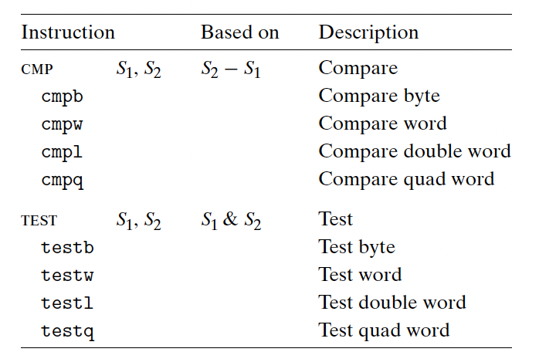
Conditional code
CF: Carry flag.
ZF: Zero flag.
SF: Sign flag.
OF: Overflow flag.
All arithmetic operations set conditional code, except leaq
There are some exceptions, read the book and remember them
cmp & test instructions set the CC but doesn’t change the value in registers.

Slide 27
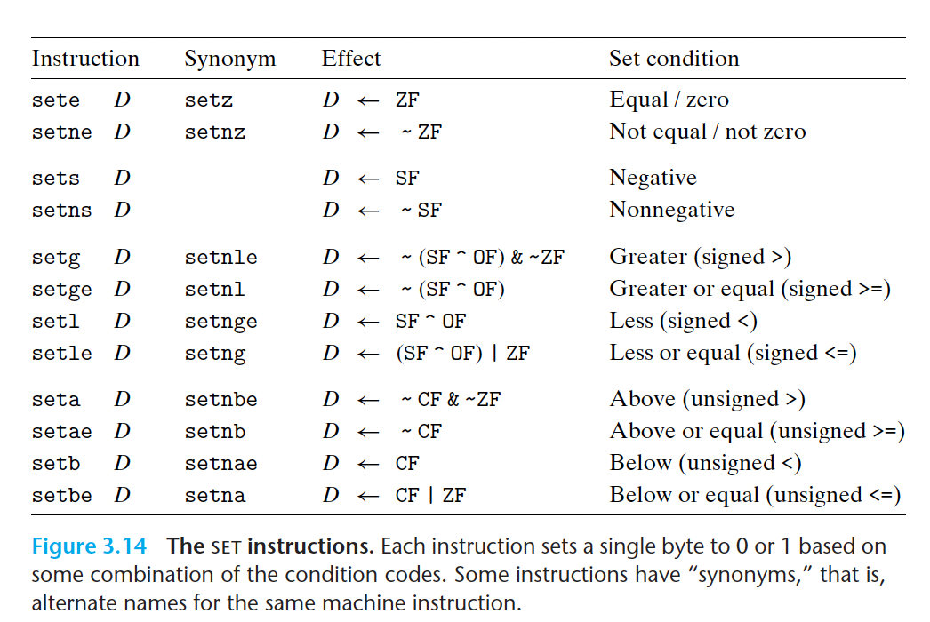
SET
Set one byte in registers or memory to zero or one according the CC.
Remember the meanings of different suffixes.

Slide 28
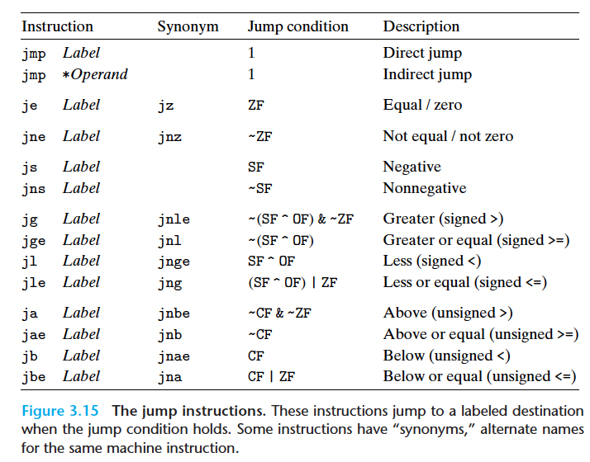
Jump and conditional jump
What is the difference between direct jump and indirect jump?
Direct jump specifies the target address explicitly.
Indirect jump reads the address from mem or reg.
All condition jumps are direct jump.
Machine code use jump and conditional jump to implement if, switch, for, while, do-whlie

Slide 29
PC-relative / absolute encoding
Done by the linker (will be covered later)
PC-relative: encode the difference between the address of the target instruction and the address of the instruction immediately following the jump.
Absolute: using 4 bytes to directly specify the target.
What is the advantage of PC-relative encoding?
Compact encoding
Position independence

Slide 30
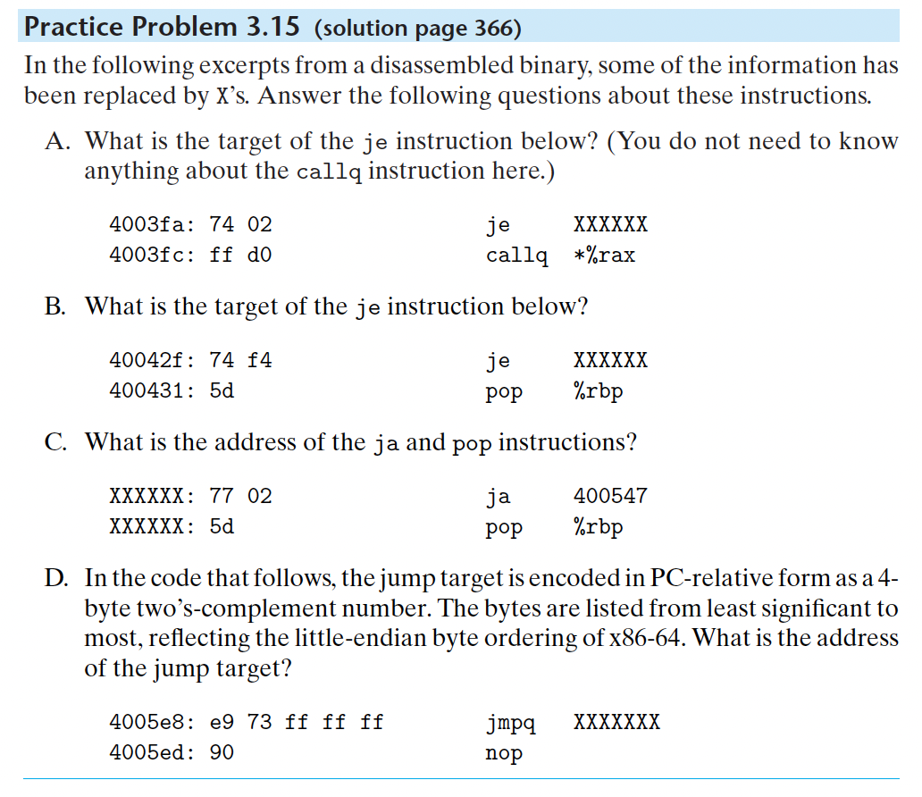
Examples

Slide 31
Examples
A: 0x4003fe
B: 0x400425
C(1): 0x400543
(2): 0x400545
D: 0x400560

Slide 32
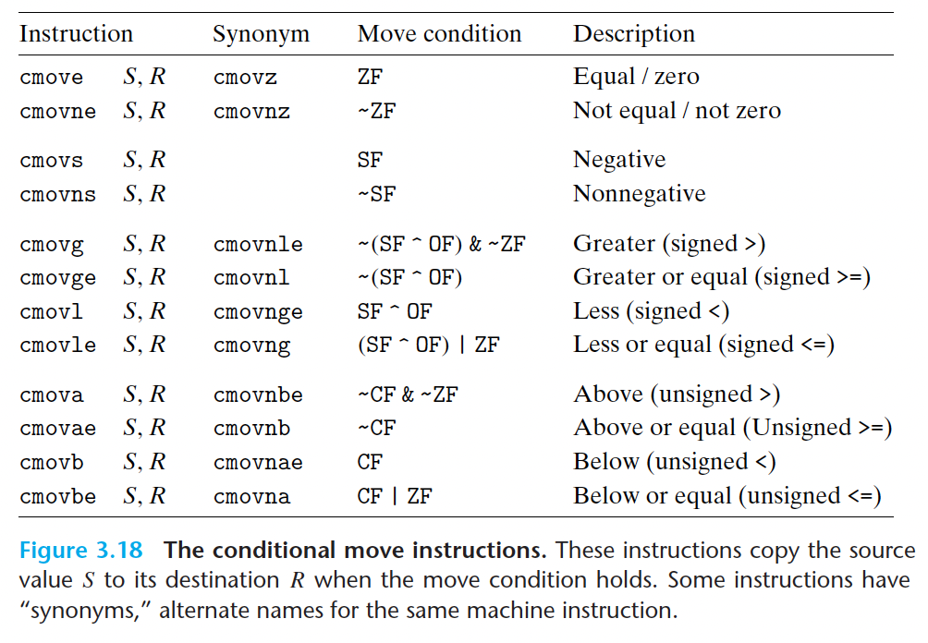
Condition move
Source: registers or memory address
Destination: register
Can’t transfer single byte data.
Operand length is not explicitly encoded in the instruction name.

Slide 33
Conditional data transfer v.s. Conditional control transfer
Advantage:
more efficient
Better for pipelining. (You will learn more about pipeline in chapter four, for now , you can think of pipeline as instructions overlapping.)
Disadvantage:
Not all conditional expressions can be compiled using conditional moves. (side effect)
What if the expression is complicated? – waste of time.

Slide 34
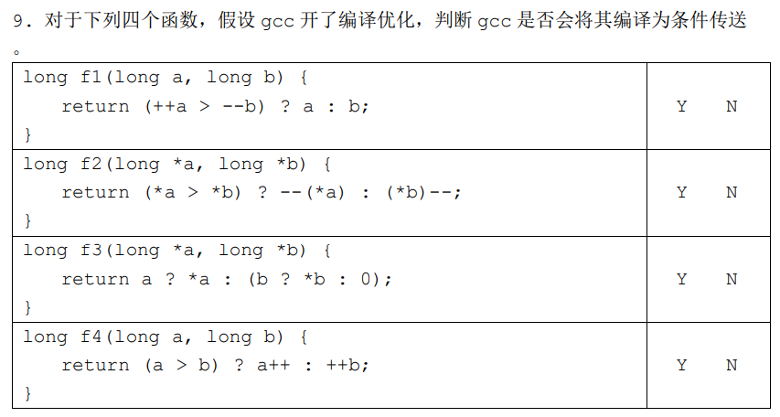
Examples

Slide 35
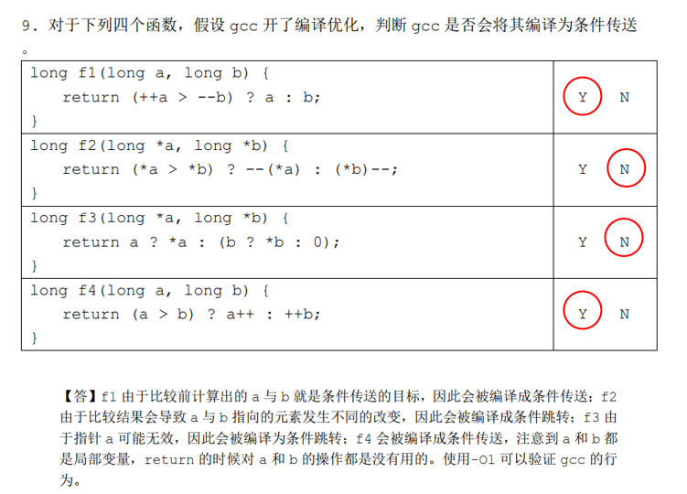
Examples

Slide 36
do-while

Slide 37
While loop- jump to middle

Slide 38
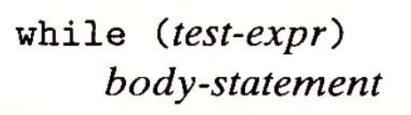
While loop- guarded do

Slide 39
For loop

Slide 40
Switch & jump table
How is switch different from if else?
Use different index to jump to different code sections.
The number of cases doesn’t affect the execution time.
How to implement switch?
Jump table!
Indirect jump!

Slide 41
Switch & jump table
See how the jump table handles default, break, and fall through

Slide 42
Example
假设某条 C 语言 switch 语句编译后产生了如下的汇编代码及跳转表：
在源程序中,下面的哪些(个)标号出现过____.
A. '2', '7' B. 1
C. '3' D. 5
movl 8(%ebp), %eax subl $48, %eax cmpl $8, %eax ja .L2 jmp *.L7(, %eax, 4) | .L7: .long .L3 .long .L2 .long .L2 .long .L5 .long .L4 .long .L5 .long .L6 .long .L2 .long .L3

Slide 43
Example
假设某条 C 语言 switch 语句编译后产生了如下的汇编代码及跳转表：
在源程序中,下面的哪些(个)标号出现过____. C
A. '2', '7' B. 1
C. '3' D. 5
movl 8(%ebp), %eax subl $48, %eax cmpl $8, %eax ja .L2 jmp *.L7(, %eax, 4) | .L7: .long .L3 .long .L2 .long .L2 .long .L5 .long .L4 .long .L5 .long .L6 .long .L2 .long .L3

